Slide 1

ENGINEERING MECHANICS
UNIT-II Chapter – 4
COPLANAR NON-CONCURRENT FORCE SYSTEM(EQUILIBRIUM)
Basanagouda I. Patil
Assistant Professor
School of Civil Engineering

Slide 2
Chapter Content:
Conditions of Equilibrium, Types of supports and reactions for 2D structures, statically determinate beam, loads acting on the beam.
Determination of support reactions and Numerical problems on equilibrium of coplanar non-concurrent force system for unknown forces.

Slide 3
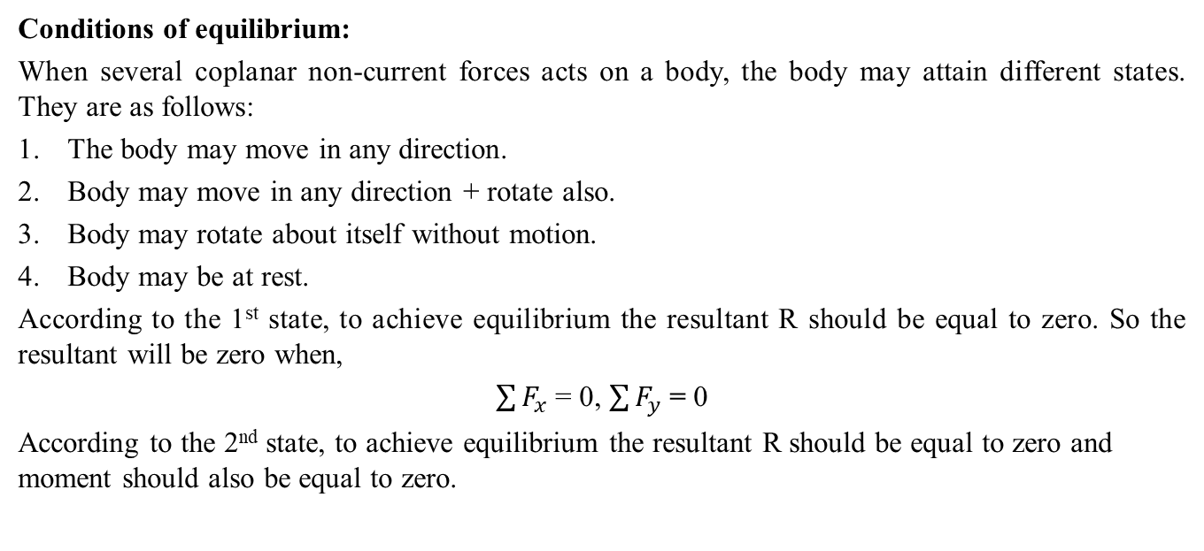
Conditions of equilibrium:
When several coplanar non-current forces acts on a body, the body may attain different states. They are as follows:
The body may move in any direction.
Body may move in any direction + rotate also.
Body may rotate about itself without motion.
Body may be at rest.
According to the 1st state, to achieve equilibrium the resultant R should be equal to zero. So the resultant will be zero when,
$\sum{F_{x}}$ = 0, $\sum{F_{y}}$ = 0
According to the 2nd state, to achieve equilibrium the resultant R should be equal to zero and moment should also be equal to zero.

Slide 4
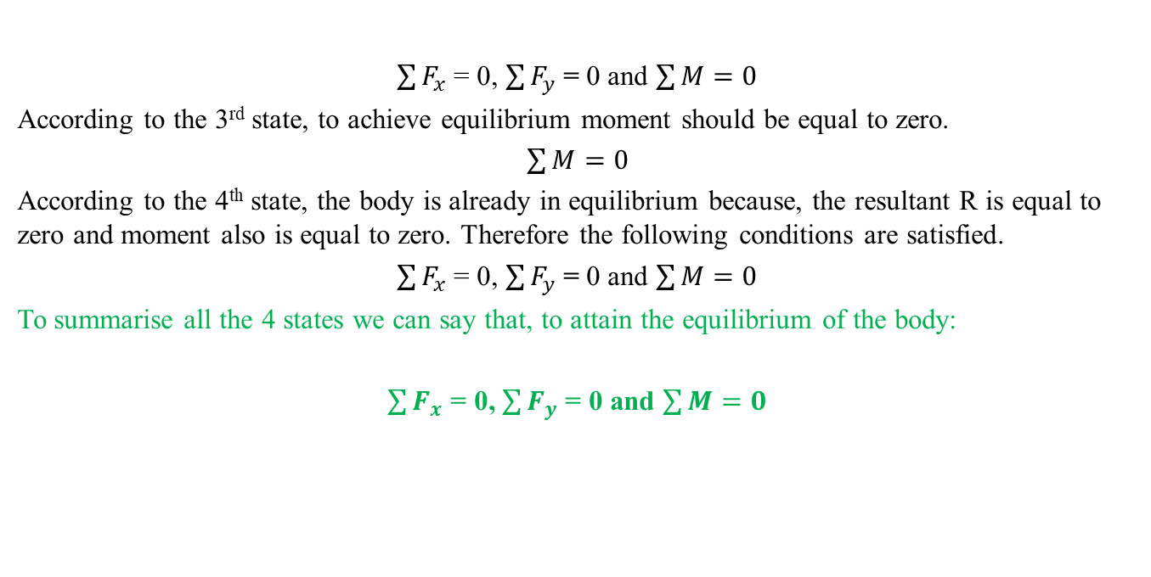
$\sum{F_{x}}$ = 0, $\sum{F_{y}}$ = 0 and $\sum{M=0}$
According to the 3rd state, to achieve equilibrium moment should be equal to zero.
$\sum{M=0}$
According to the 4th state, the body is already in equilibrium because, the resultant R is equal to zero and moment also is equal to zero. Therefore the following conditions are satisfied.
$\sum{F_{x}}$ = 0, $\sum{F_{y}}$ = 0 and $\sum{M=0}$
To summarise all the 4 states we can say that, to attain the equilibrium of the body:
$\sum{F_{x}}$ = 0, $\sum{F_{y}}$ = 0 and $\sum{M=0}$

Slide 5
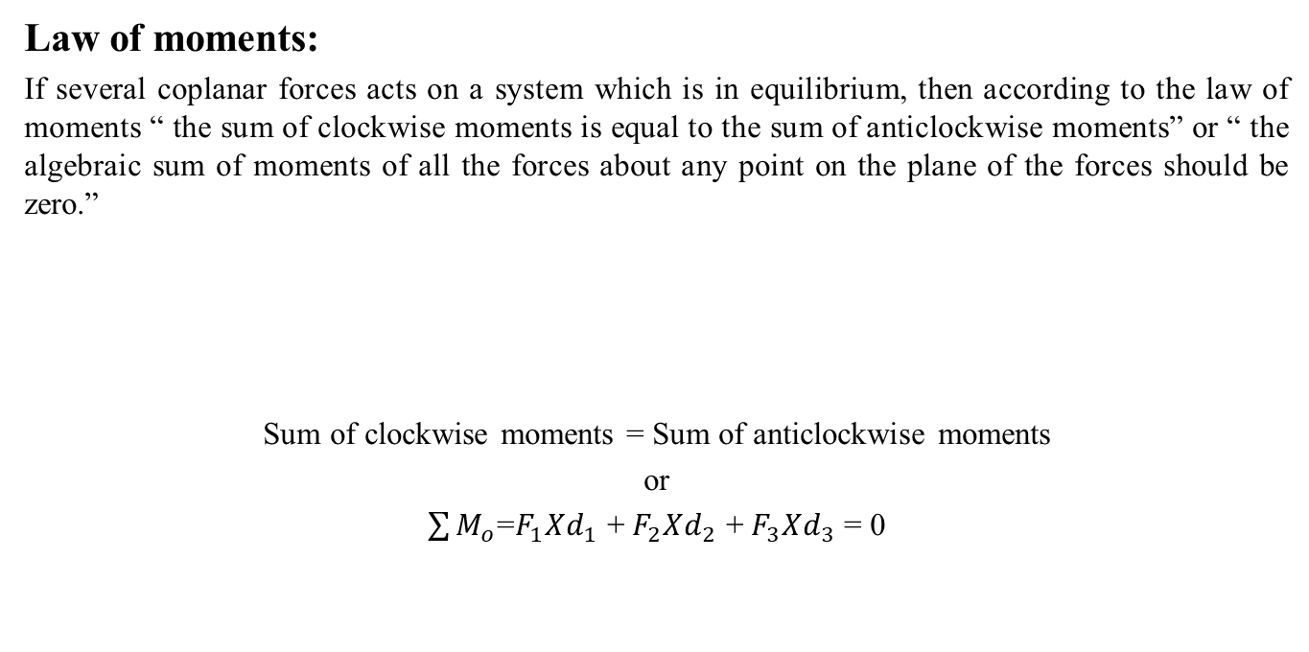



Law of moments:
If several coplanar forces acts on a system which is in equilibrium, then according to the law of moments “ the sum of clockwise moments is equal to the sum of anticlockwise moments” or “ the algebraic sum of moments of all the forces about any point on the plane of the forces should be zero.”
Sum of clockwise moments = Sum of anticlockwise moments
or
$\sum{M_{o}}$=$F_{1}Xd_{1}$ + $F_{2}Xd_{2}$ + $F_{3}Xd_{3}$ = 0
O
$$F_{1}$$
$$F_{2}$$
$$F_{3}$$

Slide 6
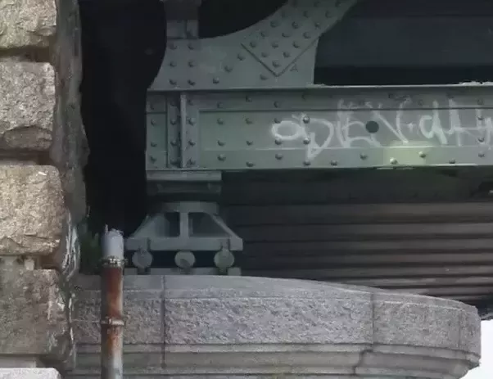




Types of supports and their reactions:
1. Reactions equivalent to a force with known line of action.
Roller.
Rocker.
Smooth surface.
In all the above supports the movement of the body is restrained in only vertical direction therefore there will be only one reaction.

Slide 7
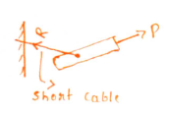

Short cable.
Short link.
In all the above supports the movement of the body is restrained in only one direction therefore there will be only one reaction along the cable or link.

Slide 8
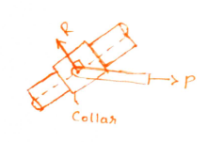
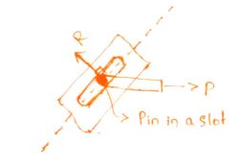
Collar on frictionless a rod.
Frictionless pin in a slot.
In all the above supports the movement of the body is restrained in only one direction therefore there will be only one reaction normal to the axis of the rod..

Slide 9
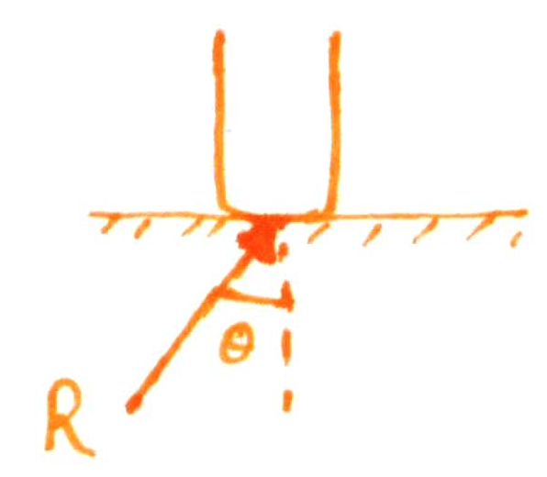
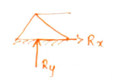
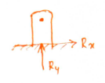

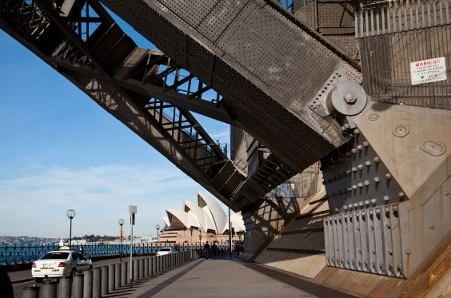

2. Reactions equivalent to a force of unknown direction.
Rough surface.
Hinges.
Frictionless pins in a fitted hole.
In all the above supports the movement of the body is restrained in two directions therefore there will be two reactions.

Slide 10
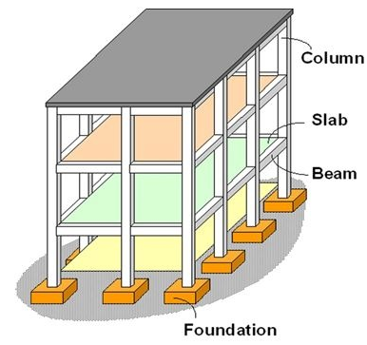
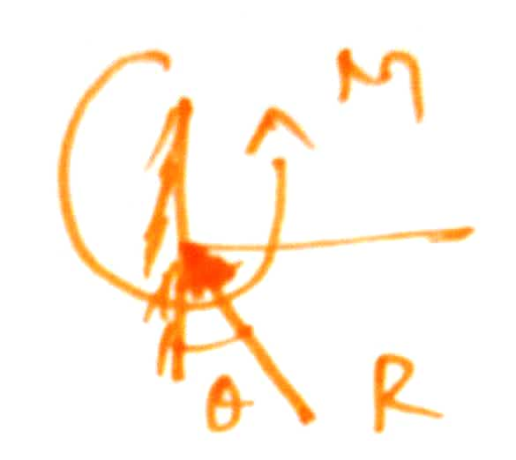
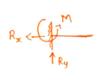
3. Reactions equivalent to a force of unknown direction and a couple.
Fixed supports.
In the above supports the movement of the body is restrained in three directions therefore there will be three reactions.
Sign conventions:
All the upward reactions are positive and downward reactions are negative.
All the right-side going reactions are positive and left side going reactions are negative.
All the clockwise moments are positive and anticlockwise moments are negative.

Slide 11
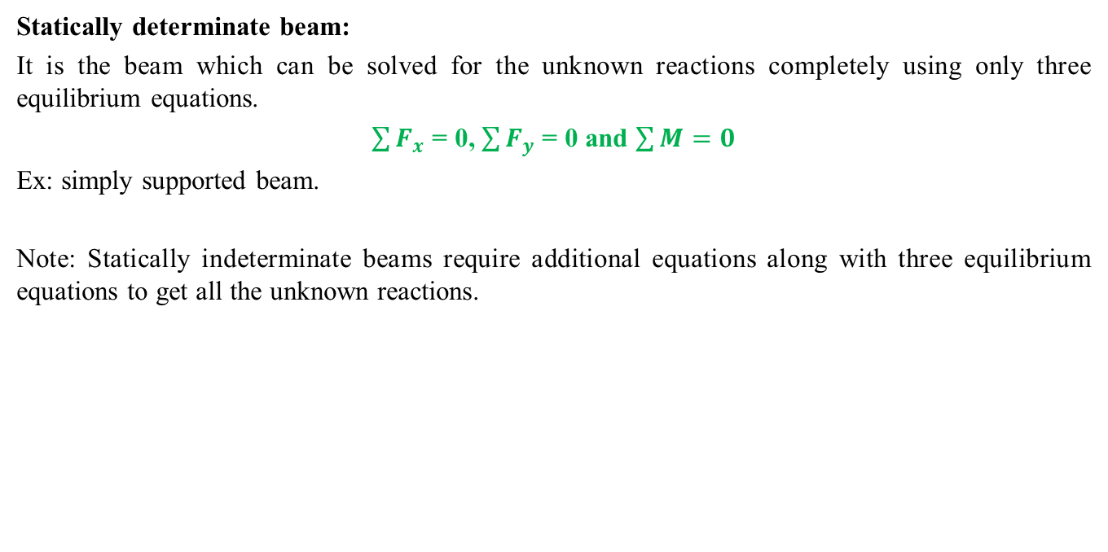
Statically determinate beam:
It is the beam which can be solved for the unknown reactions completely using only three equilibrium equations.
$\sum{F_{x}}$ = 0, $\sum{F_{y}}$ = 0 and $\sum{M=0}$
Ex: simply supported beam.
Note: Statically indeterminate beams require additional equations along with three equilibrium equations to get all the unknown reactions.

Slide 12
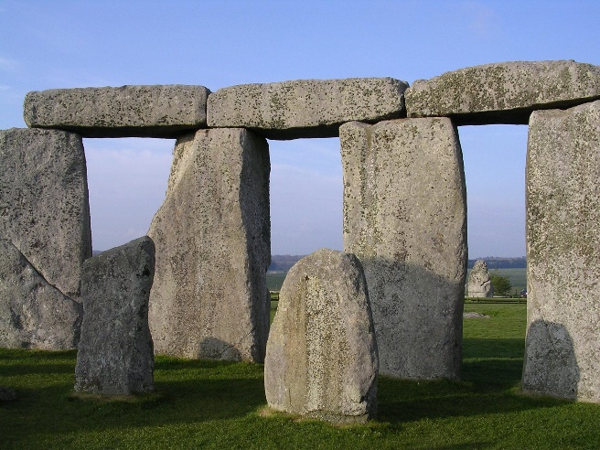
Types of beams:
Based on the support conditions we have following types of beams.
Simply supported beam:
The beam which has simple supports at either end is known as simply supported beam.
Ex:

Slide 13
2. Roller supported beam:
The beam which has roller supports at either end is known as roller supported beam.
Ex:
3. Hinged/pinned supported beam:
The beam which has hinged or pinned supports at either end is known as hinged/pinned supported beam.
Ex:

Slide 14
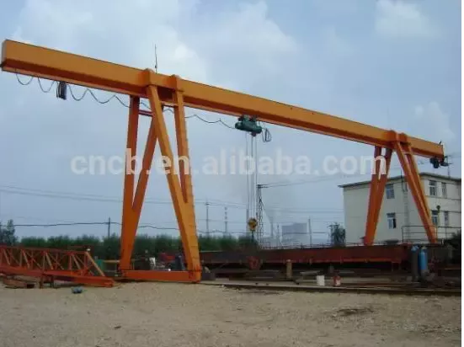
4. Overhanging beam
The beam in which certain length is extended beyond the supports is called as overhanging beam.
Ex:

Slide 15
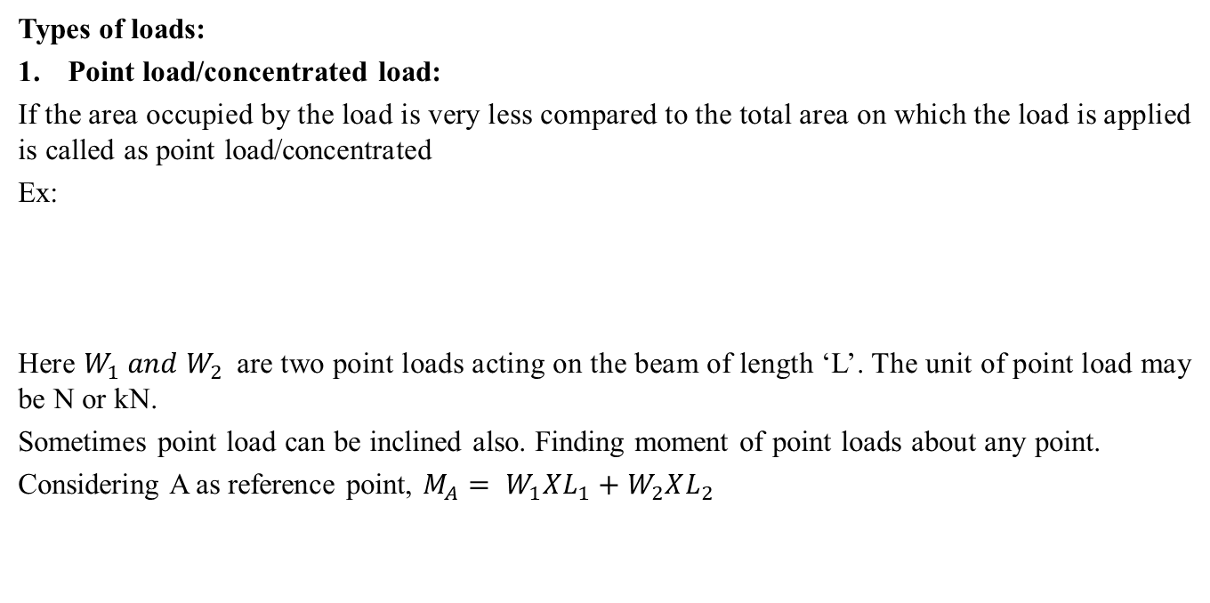
Types of loads:
Point load/concentrated load:
If the area occupied by the load is very less compared to the total area on which the load is applied is called as point load/concentrated
Ex:
Here $W_{1} and W_{2}$are two point loads acting on the beam of length ‘L’. The unit of point load may be N or kN.
Sometimes point load can be inclined also. Finding moment of point loads about any point.
Considering A as reference point, $M_{A}= W_{1}XL_{1}+W_{2}XL_{2}$
W₁
W₂
A
B
L₁
L₂
L

Slide 16
2. Uniformly distributed load (UDL):
The load which is spread over a member in such a way that, the intensity of this load remains constant over each unit length of the member.
Consider the above figure in which a simply supported beam is loaded with UDL over its entire length ‘L’.
For UDL two things are very important:
Intensity of load = ‘w’ per unit length either in N/m of kN/m (depending on the unit of force)
Span of the load = l in ‘m’
For the above figure span of the UDL is equal to span of the beam
i.e. l = L
w/m
A
B
L

Slide 17
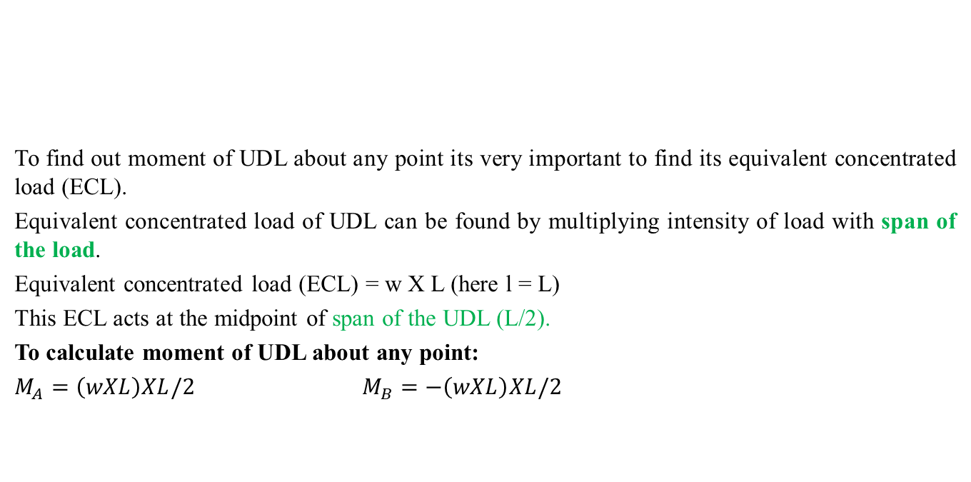
(w x L)
w/m
To find out moment of UDL about any point its very important to find its equivalent concentrated load (ECL).
Equivalent concentrated load of UDL can be found by multiplying intensity of load with span of the load.
Equivalent concentrated load (ECL) = w X L (here l = L)
This ECL acts at the midpoint of span of the UDL (L/2).
To calculate moment of UDL about any point:
$M_{A}=\left(wXL\right)XL/2$ $M_{B}=−\left(wXL\right)XL/2$
A
B
L/2
L/2
L

Slide 18
3. Uniformly varying load (UVL): Triangular variation UVL
The load which is spread over a member in such a way that, the intensity of this load varies uniformly over each unit length of the member.
Consider the above figure in which a simply supported beam is loaded with UVL over its entire length ‘L’.
For UVL two things are very important:
Intensity of load = ‘w’ per unit length either in N/m of kN/m (depending on the unit of force)
Span of the load = l
For the above figure span of the UVL is equal to span of the beam
i.e. l = L
w/m
A
B
L

Slide 19
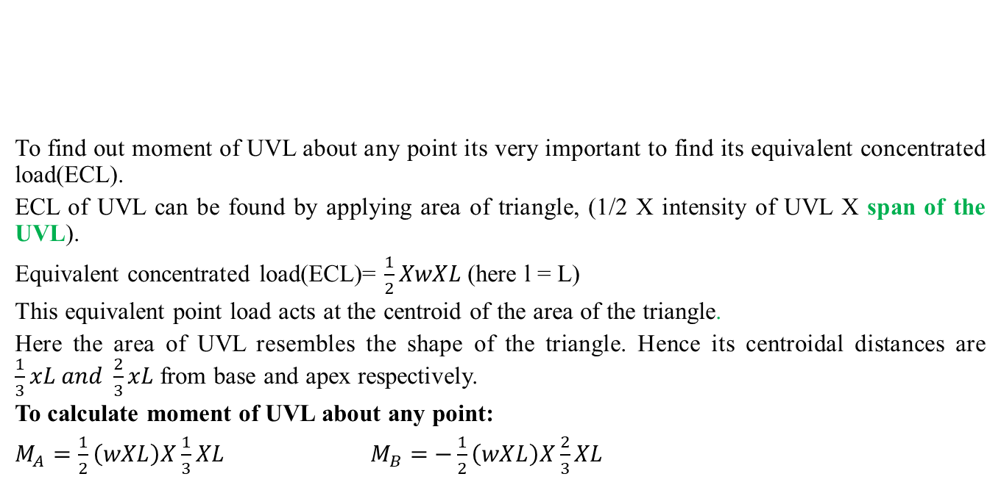
1/2X(w X L)
w/m
To find out moment of UVL about any point its very important to find its equivalent concentrated load(ECL).
ECL of UVL can be found by applying area of triangle, (1/2 X intensity of UVL X span of the UVL).
Equivalent concentrated load(ECL)= $\frac{1}{2}XwXL$(here l = L)
This equivalent point load acts at the centroid of the area of the triangle.
Here the area of UVL resembles the shape of the triangle. Hence its centroidal distances are $\frac{1}{3}xL and \frac{2}{3}xL$from base and apex respectively.
To calculate moment of UVL about any point:
$M_{A}=\frac{1}{2}\left(wXL\right)X\frac{1}{3}XL M_{B}=$ $−\frac{1}{2}\left(wXL\right)X\frac{2}{3}XL$
A
B
_{1/3 x L}
_{2/3 x L}
L

Slide 20
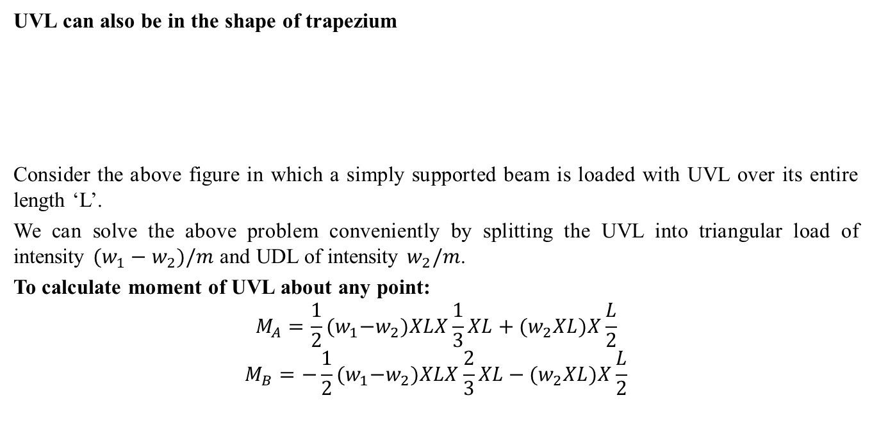
w₁/m
w₁-w₂
UVL can also be in the shape of trapezium
Consider the above figure in which a simply supported beam is loaded with UVL over its entire length ‘L’.
We can solve the above problem conveniently by splitting the UVL into triangular load of intensity $(w_{1}−w_{2})/m$ and UDL of intensity $w_{2}/m$.
To calculate moment of UVL about any point:
$$M_{A}=\frac{1}{2}{(w}_{1}−w_{2})XLX\frac{1}{3}XL+(w_{2}XL)X\frac{L}{2}$$
$$M_{B}=−\frac{1}{2}{(w}_{1}−w_{2})XLX\frac{2}{3}XL−(w_{2}XL)X\frac{L}{2}$$
w₂/m
B
A
L

Slide 21
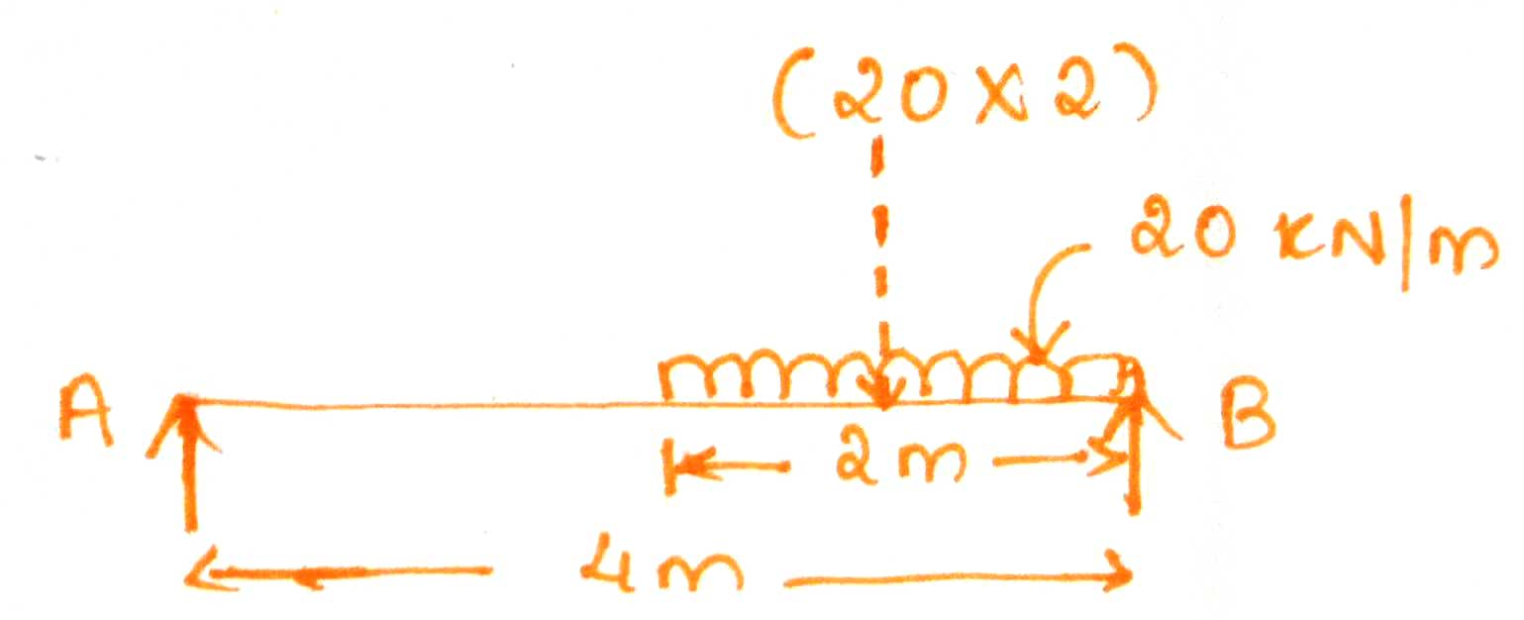
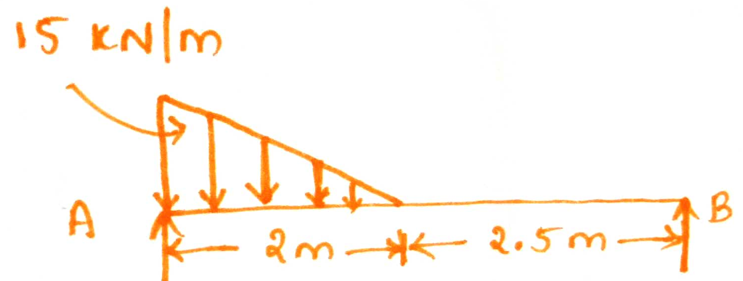

Some examples on various loadings:
To find $M_{A }and M_{B}$:
For the beam given in Fig. ‘a’ $M_{A }=\left(20X2\right)X\left(2+\frac{2}{2}\right)$= 120 kNm
$M_{B }=−\left(20X2\right)X\left(\frac{2}{2}\right)$= - 40 kNm
For the beam given in Fig. ‘b’ $M_{A }=\left(\frac{1}{2}X15X2\right)X\left(\frac{1}{3}X2\right)$ = 10 kNm
$M_{B }=−\left(\frac{1}{2}X15X2\right)X\left(\frac{2}{3}X2+2.5\right)$ = -57.5 kNm
Fig. ‘a’
Fig. ‘b’

Slide 22
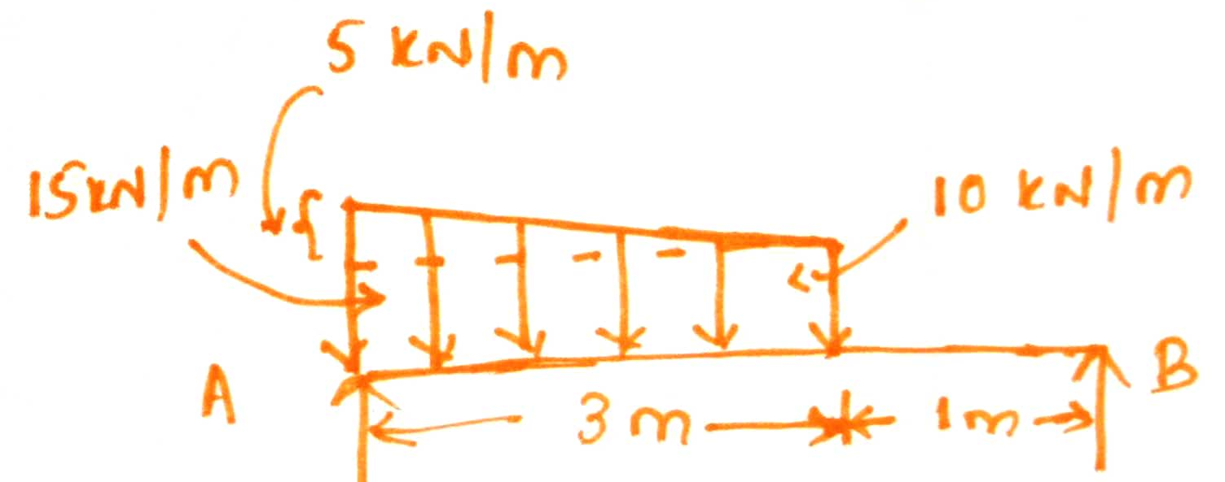

To find $M_{A }and M_{B}$:
For the beam given in Fig. ‘c’ $M_{A }=\left(10X3\right)X\left(\frac{3}{2}\right)$+$\left(\frac{1}{2}X5X3\right)X(\frac{1}{3}X3)$= 52.5 kNm
$M_{B }=−\left(10X3\right)X\left(\frac{3}{2}+1\right)$-$\left(\frac{1}{2}X5X3\right)X(\frac{2}{3}X3+1)$= - 97.5 kNm
Fig. ‘c’

Slide 23
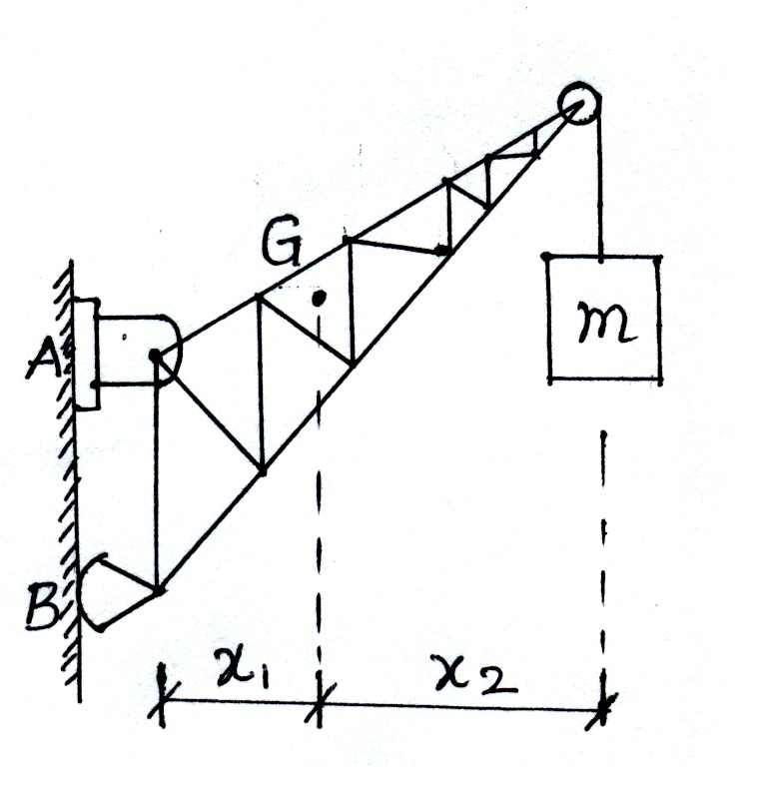
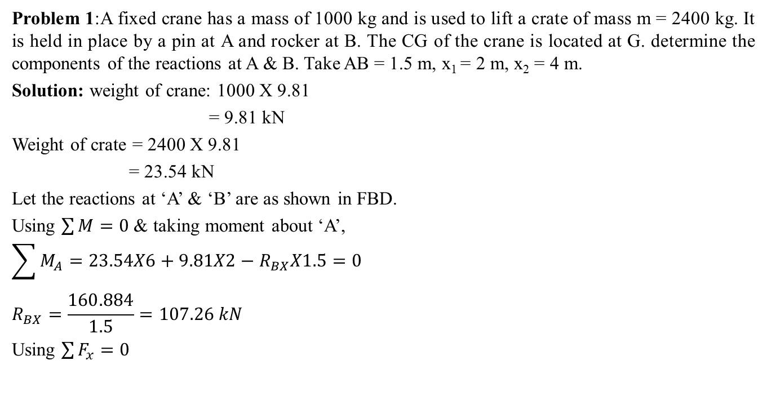



Problem 1:A fixed crane has a mass of 1000 kg and is used to lift a crate of mass m = 2400 kg. It is held in place by a pin at A and rocker at B. The CG of the crane is located at G. determine the components of the reactions at A & B. Take AB = 1.5 m, x₁ = 2 m, x₂ = 4 m.
Solution: weight of crane: 1000 X 9.81
= 9.81 kN
Weight of crate = 2400 X 9.81
= 23.54 kN
Let the reactions at ‘A’ & ‘B’ are as shown in FBD.
Using $\sum{M=0}$ & taking moment about ‘A’,
$$\sum{M_{A}=23.54X6+9.81X2−R_{BX}X1.5=0}$$
$$R_{BX}=\frac{160.884}{1.5}=107.26 kN$$
Using $\sum{F_{x}=0}$
FBD of crane
$$R_{AY}$$
$$R_{AX}$$
A
G
23.54 kN
9.81 kN
$$R_{BX}$$
B

Slide 24
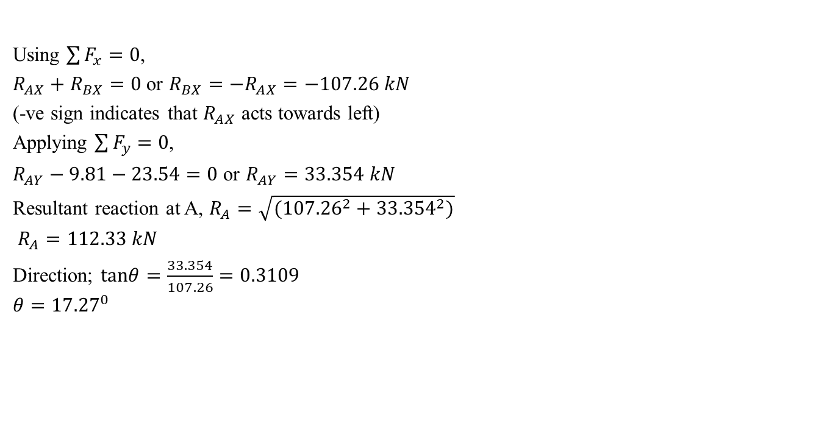
Using $\sum{F_{x}=0}$,
$R_{AX}+R_{BX}=0$ or $R_{BX}=−R_{AX}=−107.26 kN$
(-ve sign indicates that $R_{AX}$ acts towards left)
Applying $\sum{F_{y}=0}$,
$R_{AY}−9.81−23.54=0$ or $R_{AY}=33.354 kN$
Resultant reaction at A, $R_{A}=\sqrt{({107.26}^{2}+{33.354}^{2})}$
$R_{A}=112.33 kN$
Direction; $tanθ=\frac{33.354}{107.26}=0.3109$
$$θ={17.27}^{0}$$
FBD of crane
$$R_{AY}$$
$$R_{AX}$$
A
G
23.54 kN
9.81 kN
$$R_{BX}$$
B

Slide 25
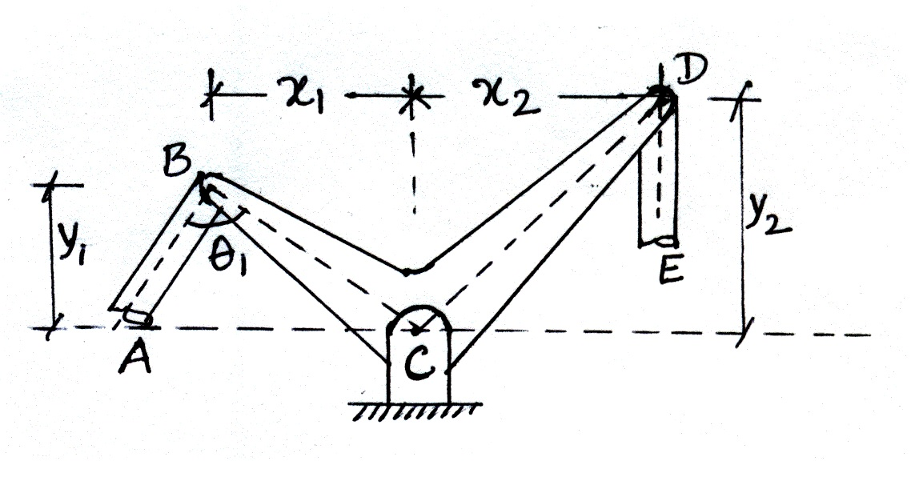

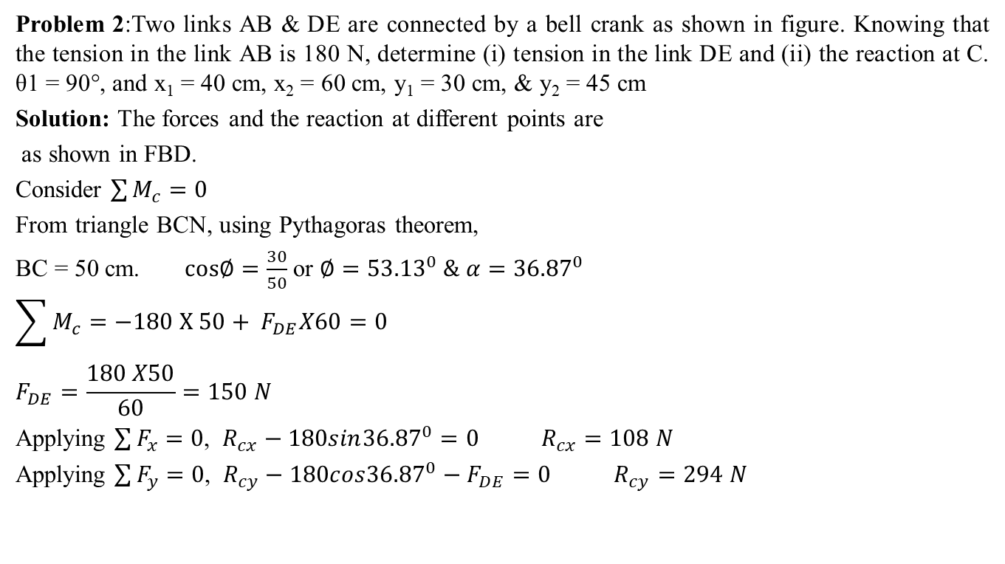





Problem 2:Two links AB & DE are connected by a bell crank as shown in figure. Knowing that the tension in the link AB is 180 N, determine (i) tension in the link DE and (ii) the reaction at C. θ1 = 90°, and x₁ = 40 cm, x₂ = 60 cm, y₁ = 30 cm, & y₂ = 45 cm
Solution: The forces and the reaction at different points are
as shown in FBD.
Consider $\sum{M_{c}}=0$
From triangle BCN, using Pythagoras theorem,
BC = 50 cm. $cos∅=\frac{30}{50}$ or $∅={53.13}^{0} \& α={36.87}^{0}$
$$\sum{M_{c}}=−180 X 50+ F_{DE}X60=0$$
$$F_{DE}=\frac{180 X50}{60}=150 N$$
Applying $\sum{F_{x}=0}$, $R_{cx}−180sin{36.87}^{0}=0$ $R_{cx}=108 N$
Applying $\sum{F_{y}=0}$, $R_{cy}−180cos{36.87}^{0}−F_{DE}=0$ $R_{cy}=294 N$
FBD of crank
D
B
$$α$$
$$∅$$
$$F_{DE}$$
$$F_{AB}=180 N$$
30 cm
C
45 cm
40 cm
60 cm
N
$$R_{cx}$$
$$R_{cy}$$

Slide 26

$R_{A}=\sqrt{({108}^{2}+{294}^{2})}$ = 313.21 N
Direction $tanθ=\frac{294}{108}$ $θ={69.82}^{0}$
FBD of crank
D
B
$$α$$
$$∅$$
$$F_{DE}$$
$$F_{AB}=180 N$$
30 cm
C
45 cm
40 cm
60 cm
N
$$R_{cx}$$
$$R_{cy}$$

Slide 27
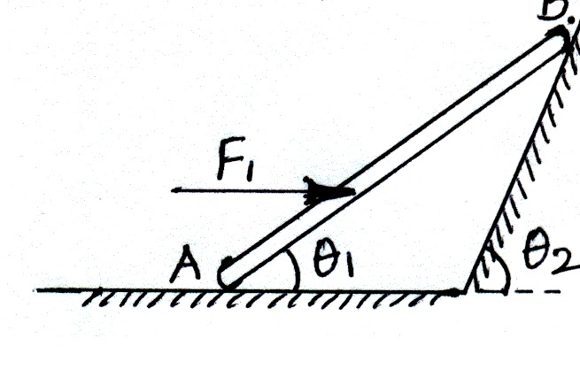

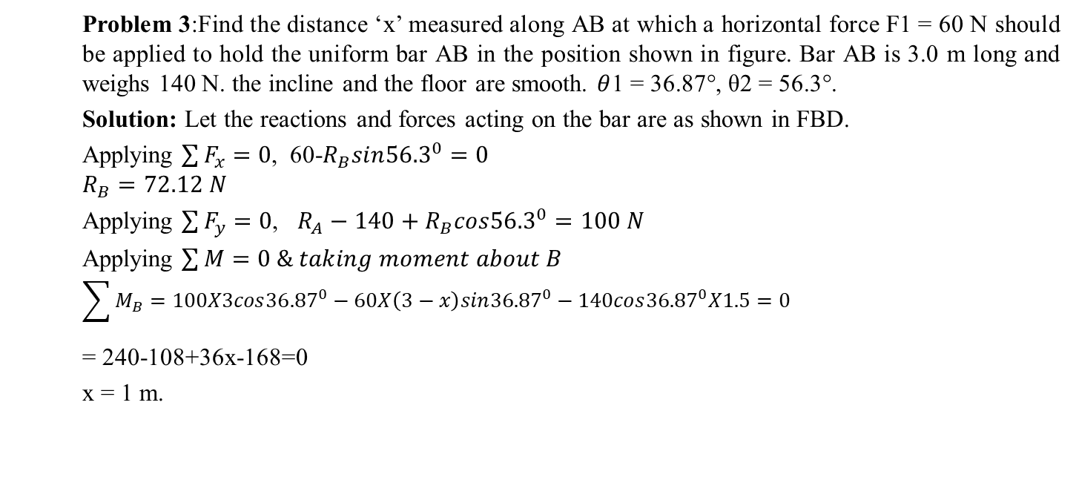




Problem 3:Find the distance ‘x’ measured along AB at which a horizontal force F1 = 60 N should be applied to hold the uniform bar AB in the position shown in figure. Bar AB is 3.0 m long and weighs 140 N. the incline and the floor are smooth. $θ$1 = 36.87°, θ2 = 56.3°.
Solution: Let the reactions and forces acting on the bar are as shown in FBD.
Applying $\sum{F_{x}=0}$, 60-$R_{B}sin{56.3}^{0}=0$
$$R_{B}=72.12 N$$
Applying $\sum{F_{y}=0}$, $R_{A}−140+R_{B}cos{56.3}^{0}=100 N$
Applying $\sum{M}=0 \& taking moment about B$
$$\sum{M_{B}=100X3cos{36.87}^{0}−60X\left(3−x\right)sin{36.87}^{0}−140cos{36.87}^{0}X1.5=0}$$
= 240-108+36x-168=0
x = 1 m.
B
FBD
$$α$$
$$R_{B}$$
60 N
x
140 N
A
$$θ_{1}$$
$$θ_{2}$$
$$R_{A}$$

Slide 28
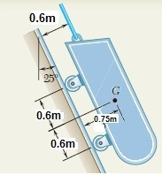
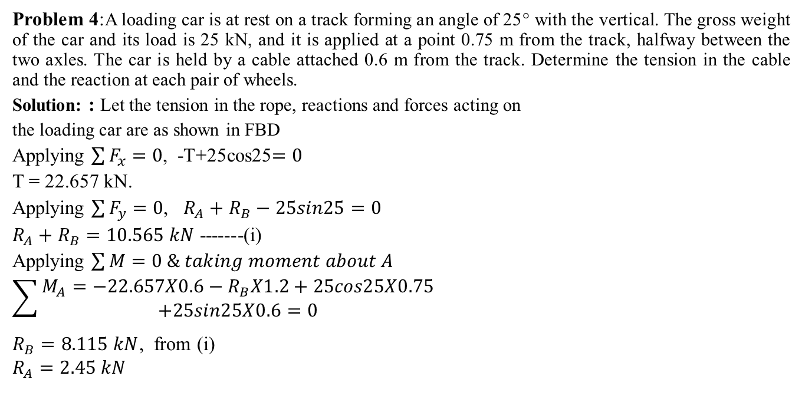



Problem 4:A loading car is at rest on a track forming an angle of 25° with the vertical. The gross weight of the car and its load is 25 kN, and it is applied at a point 0.75 m from the track, halfway between the two axles. The car is held by a cable attached 0.6 m from the track. Determine the tension in the cable and the reaction at each pair of wheels.
Solution: : Let the tension in the rope, reactions and forces acting on
the loading car are as shown in FBD
Applying $\sum{F_{x}=0}$, -T+25cos25$=0$
T = 22.657 kN.
Applying $\sum{F_{y}=0}$, $R_{A}+R_{B}−25sin25=0$
$R_{A}+R_{B}=10.565 kN$ -------(i)
Applying $\sum{M}=0 \& taking moment about A$
$$\sum{\begin{aligned}M_{A}=−22.657X0.6−R_{B}X1.2+25cos25X0.75 \\ +25sin25X0.6=0\end{aligned}}$$
$R_{B}=8.115 kN$, from (i)
$$R_{A}=2.45 kN$$
A
FBD
T
0.6 m
B
$${25}^{0}$$
A
0.75 m
G
$$R_{A}$$
1.2 m
25 kN
$$R_{B}$$
B

Slide 29
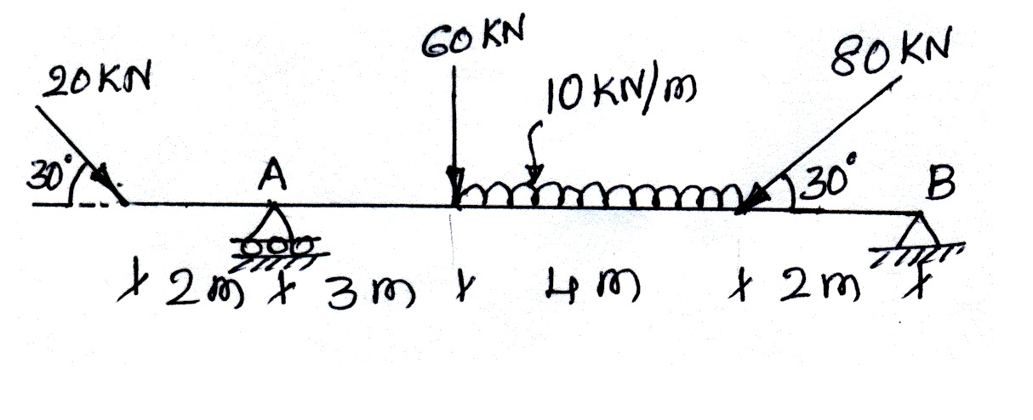
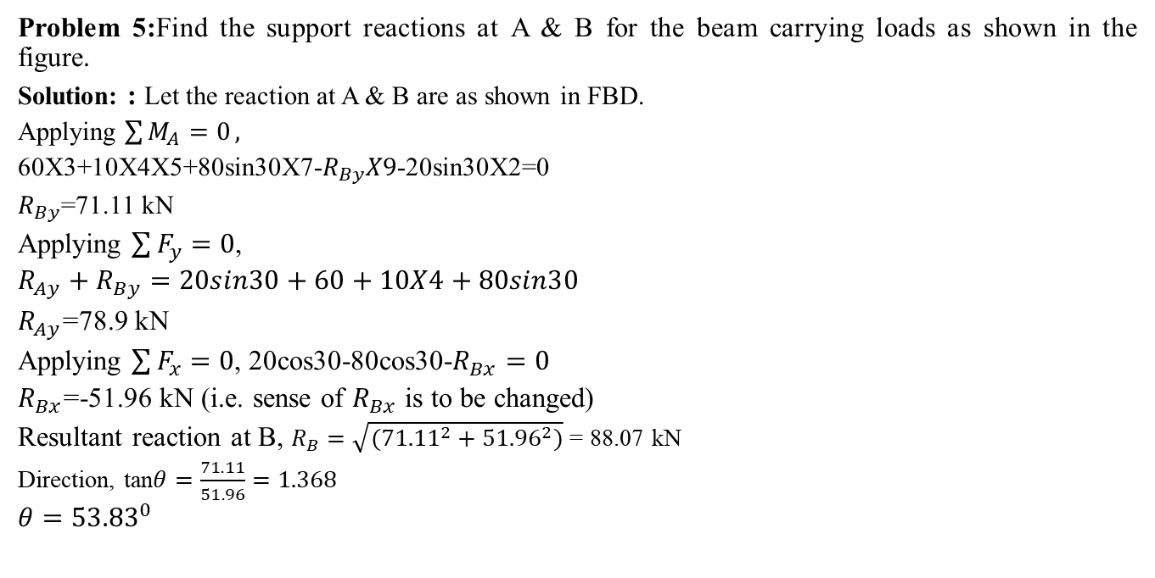



Problem 5:Find the support reactions at A & B for the beam carrying loads as shown in the figure.
Solution: : Let the reaction at A & B are as shown in FBD.
Applying $\sum{M_{A}=0},$
60X3+10X4X5+80sin30X7-$R_{By}X9$-20sin30X2=0
$R_{By}$=71.11 kN
Applying $\sum{F_{y}=0}$,
$$R_{Ay}+R_{By}=20sin30+60+10X4+80sin30$$
$R_{Ay}$=78.9 kN
Applying $\sum{F_{x}=0}$, 20cos30-80cos30-$R_{Bx}=0$
$R_{Bx}$=-51.96 kN (i.e. sense of $R_{Bx}$ is to be changed)
Resultant reaction at B, $R_{B}=\sqrt{({71.11}^{2}+{51.96}^{2})}$ = 88.07 kN
Direction, tan$θ=\frac{71.11}{51.96}=1.368$
$$θ={53.83}^{0}$$
FBD
$$R_{Bx}$$
$$R_{Ay}$$
$$R_{By}$$

Slide 30
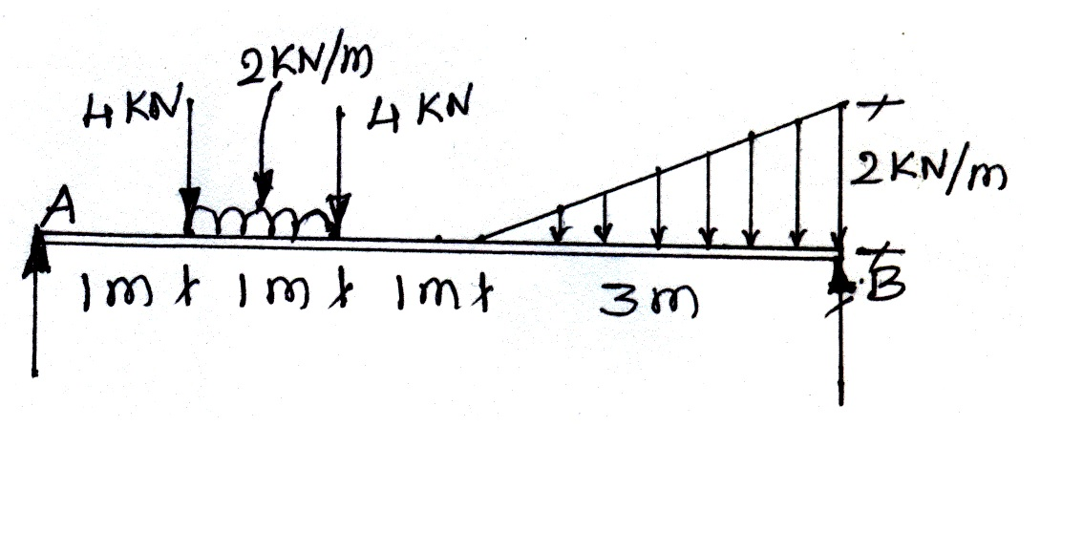
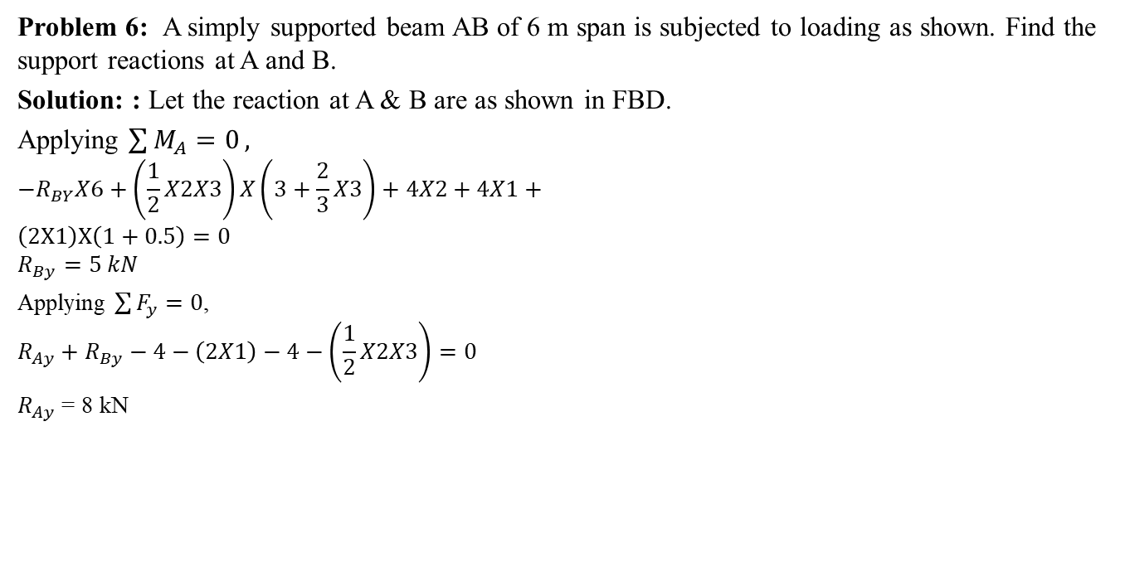


Problem 6: A simply supported beam AB of 6 m span is subjected to loading as shown. Find the support reactions at A and B.
Solution: : Let the reaction at A & B are as shown in FBD.
Applying $\sum{M_{A}=0},$
$${−R}_{BY}X6+\left(\frac{1}{2}X2X3\right)X\left(3+\frac{2}{3}X3\right)+4X2+4X1+$$
$$\left(2X1\right)X\left(1+0.5\right)=0$$
$$R_{By}=5 kN$$
Applying $\sum{F_{y}=0}$,
$$R_{Ay}+R_{By}−4−\left(2X1\right)−4−\left(\frac{1}{2}X2X3\right)=0$$
$R_{Ay}$ = 8 kN
$$R_{Ay}$$
$$R_{By}$$

Slide 31
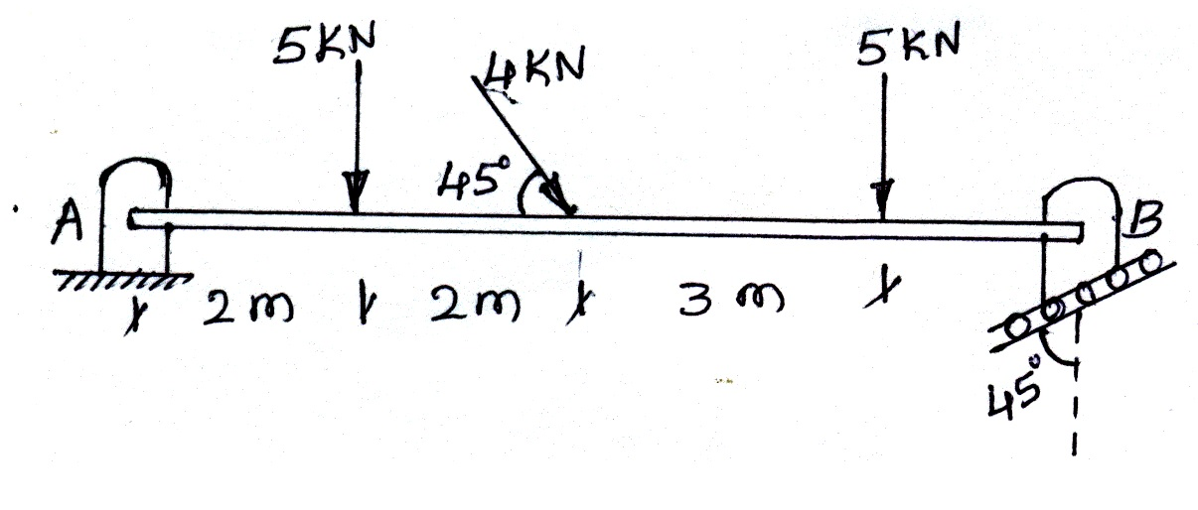
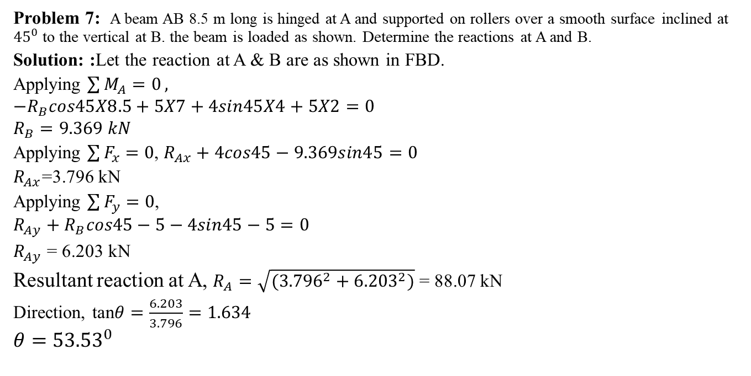



Problem 7: A beam AB 8.5 m long is hinged at A and supported on rollers over a smooth surface inclined at ${45}^{0}$ to the vertical at B. the beam is loaded as shown. Determine the reactions at A and B.
Solution: :Let the reaction at A & B are as shown in FBD.
Applying $\sum{M_{A}=0},$
$${−R}_{B}cos45X8.5+5X7+4sin45X4+5X2=0$$
$$R_{B}=9.369 kN$$
Applying $\sum{F_{x}=0}$, $R_{Ax}+4cos45−9.369sin45=0$
$R_{Ax}$=3.796 kN
Applying $\sum{F_{y}=0}$,
$$R_{Ay}+R_{B}cos45−5−4sin45−5=0$$
$R_{Ay}$ = 6.203 kN
Resultant reaction at A, $R_{A}=\sqrt{({3.796}^{2}+{6.203}^{2})}$ = 88.07 kN
Direction, tan$θ=\frac{6.203}{3.796}=1.634$
$$θ={53.53}^{0}$$
$$R_{Ax}$$
$$R_{Ay}$$
$$R_{B}$$

Slide 32
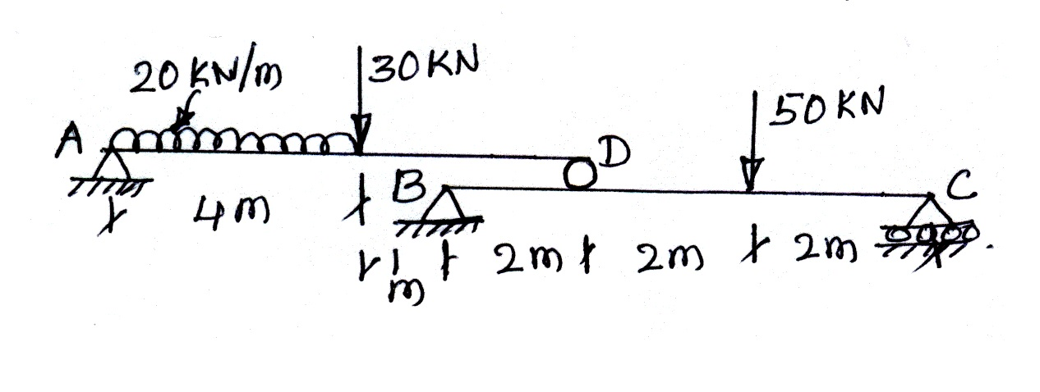
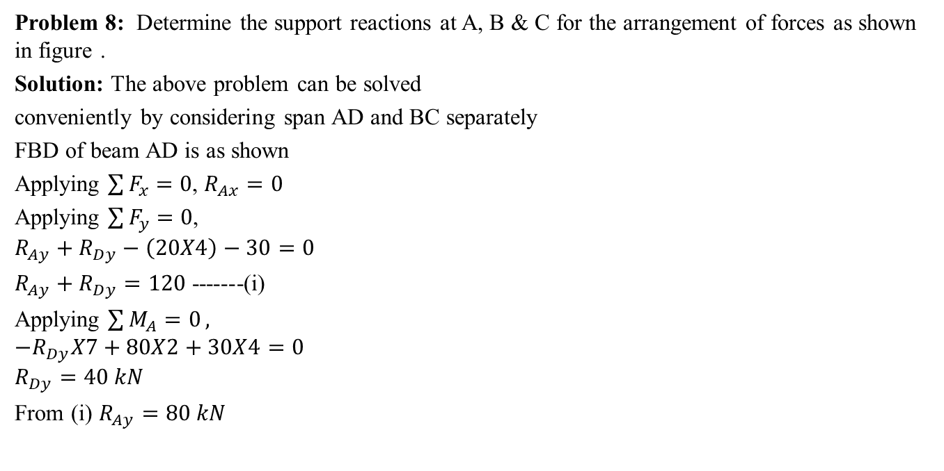



Problem 8: Determine the support reactions at A, B & C for the arrangement of forces as shown in figure .
Solution: The above problem can be solved
conveniently by considering span AD and BC separately
FBD of beam AD is as shown
Applying $\sum{F_{x}=0}$, $R_{Ax}=0$
Applying $\sum{F_{y}=0}$,
$$R_{Ay}+R_{Dy}−\left(20X4\right)−30=0$$
$R_{Ay}+R_{Dy}=120$ -------(i)
Applying $\sum{M_{A}=0},$
$${−R}_{Dy}X7+80X2+30X4=0$$
$$R_{Dy}=40 kN$$
From (i) $R_{Ay}=80 kN$
(20 X 4)
30 kN
$$R_{Ax}$$
A
D
2 m
2 m
3 m
$$R_{Ay}$$
$$R_{Dy}$$

Slide 33



40 kN
50 kN
The reaction $R_{Dy}$ will act as a point load on span BC
FBD of beam BC is as shown
Applying $\sum{F_{x}=0}$, $R_{Bx}=0$
Applying $\sum{F_{y}=0}$,
$$R_{By}+R_{Cy}−40−50=0$$
$R_{By}+R_{Cy}=90$ -------(ii)
Applying $\sum{M_{B}=0},$
$${−R}_{Cy}X6+40X2+50X4=0$$
$$R_{Cy}=46.66 kN$$
From (ii) $R_{By}=43.33 kN$
$$R_{Bx}$$
B
C
2 m
2 m
2 m
$$R_{By}$$
$$R_{Cy}$$

Slide 34
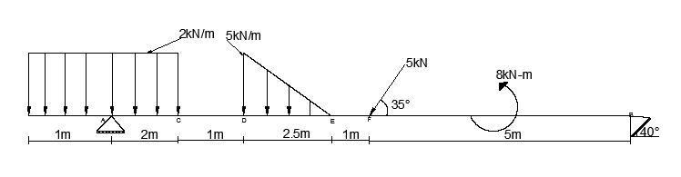
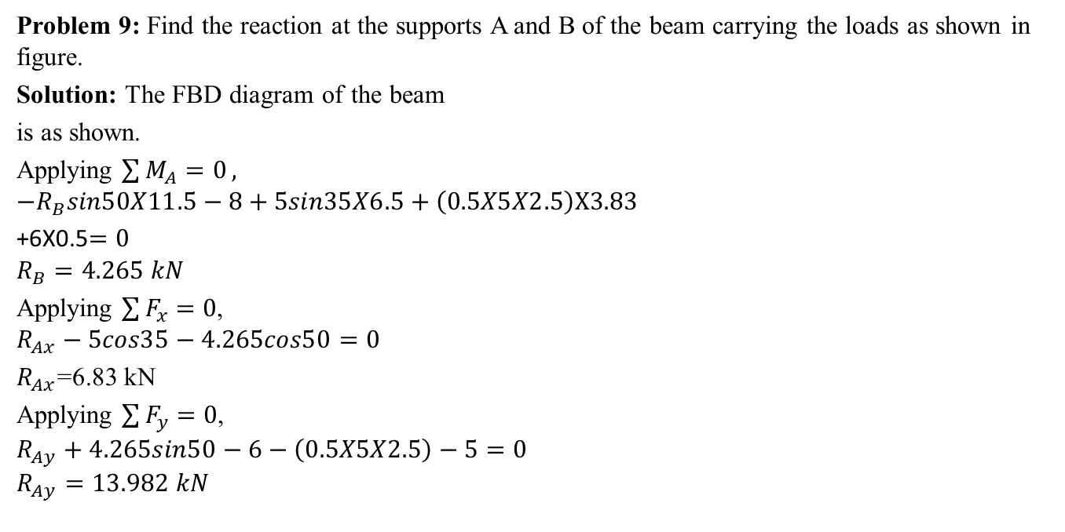





Problem 9: Find the reaction at the supports A and B of the beam carrying the loads as shown in figure.
Solution: The FBD diagram of the beam
is as shown.
Applying $\sum{M_{A}=0},$
$${−R}_{B}sin50X11.5−8+5sin35X6.5+\left(0.5X5X2.5\right)X3.83$$
+6X0.5$=0$
$$R_{B}=4.265 kN$$
Applying $\sum{F_{x}=0}$,
$$R_{Ax}−5cos35−4.265cos50=0$$
$R_{Ax}$=6.83 kN
Applying $\sum{F_{y}=0}$,
$$R_{Ay}+4.265sin50−6−\left(0.5X5X2.5\right)−5=0$$
$$R_{Ay}=13.982 kN$$
(2 X 3)
$$(\frac{1}{2}X5X2.5)$$
5 kN
8 kNm
$$R_{Ax}$$
A
C
D
E
F
$${35}^{0}$$
B
0.5 m
$${50}^{0}$$
2 m
1 m
0.83 m
1.67 m
5 m
1 m
$$R_{B}$$
$$R_{Ay}$$

Slide 35
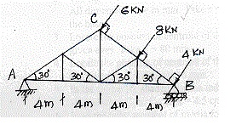
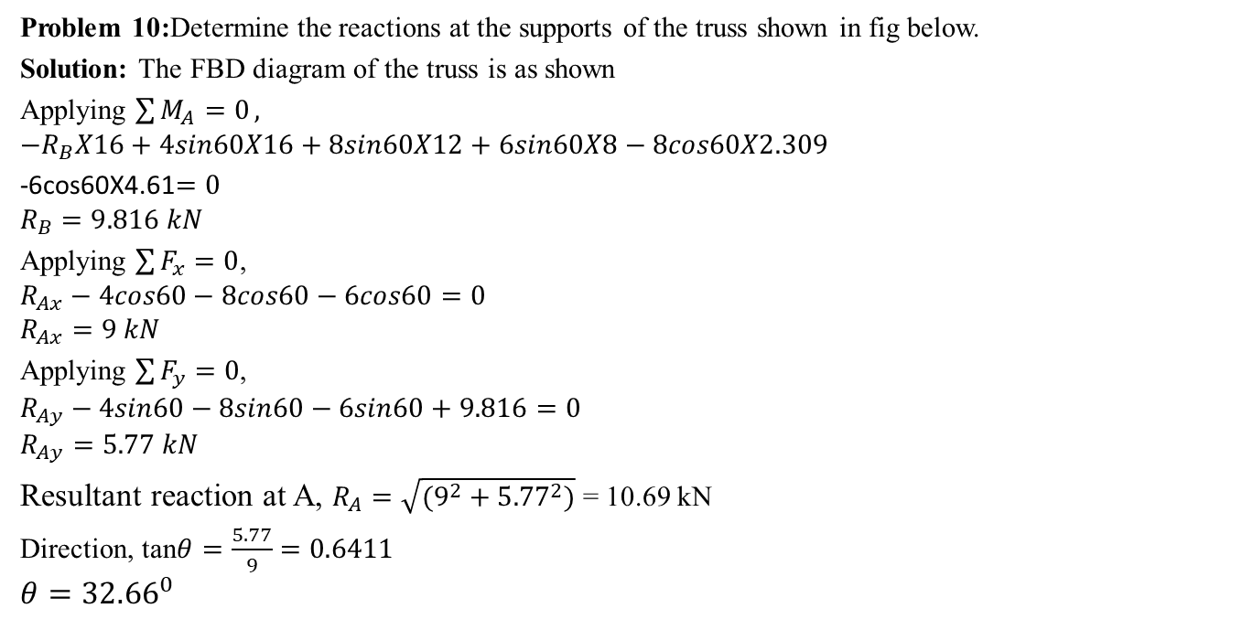
Problem 10:Determine the reactions at the supports of the truss shown in fig below.
Solution: The FBD diagram of the truss is as shown
Applying $\sum{M_{A}=0},$
$${−R}_{B}X16+4sin60X16+8sin60X12+6sin60X8−8cos60X2.309$$
-6cos60X4.61$=0$
$$R_{B}=9.816 kN$$
Applying $\sum{F_{x}=0}$,
$$R_{Ax}−4cos60−8cos60−6cos60=0$$
$$R_{Ax}=9 kN$$
Applying $\sum{F_{y}=0}$,
$$R_{Ay}−4sin60−8sin60−6sin60+9.816=0$$
$$R_{Ay}=5.77 kN$$
Resultant reaction at A, $R_{A}=\sqrt{(9^{2}+{5.77}^{2})}$ = 10.69 kN
Direction, tan$θ=\frac{5.77}{9}=0.6411$
$$θ={32.66}^{0}$$
$$R_{Ax}$$
$$R_{Ay}$$
$$R_{B}$$

Slide 36
Thank You

